Slide 1
Mech Warfare Quad-bot Walking Code
Jacob Simmonds
12/30/2019

Slide 2
Robot Overview
Robot figure shown with legs in the 2d plane
Legs
Feet
Center of mass
Leg hip

Slide 3
Stability Region Choice
Draw lines from each foot to show where the region of stability is for each.
For any triangle drawn by three feet points, if the center of mass is within the triangle then the robot is roughly stable

Slide 4
Stability Region Choice
The center of mass will always be within two stable regions, meaning the robot has to choose which leg should be up and which three legs should be down
Stable
Stable
Unstable
Unstable
One of these legs should be up. Which is best?

Slide 5
Robot leg change
The robot will change its leg if one of four things happens:
A leg hits a maximum bound
A leg hits a minimum bound
The center of mass is about to exit a region of stability to another possible region of stability
The center of mass is about to exit a region of stability to no region of stability
If two occur at once, a region of stability leg change will take precedence due to the buffer that exists in the leg bounds
If a leg hits a bound, the leg will be changed to an up-leg
If this causes an instability to occur, the robot will fix itself on the next step – possible rocking in gait from this
If a leg is exiting a region of stability to another region, the best up-leg needs to be chosen. The following slides explain how this is chosen

Slide 6
Up leg Stability Region Choice
To decide, the robot chooses the leg combination that will keep the body in a region of stability the longest.
Velocity direction

Slide 7
Stability Algorithm
It is immediately obvious to a human which leg combination is better, but for the robot we need some algorithm to determine this.
Current method: find the distance to intersection of the green velocity vector to each of the 3 lines between the feet points
Only one of these 3 lines will intersect with a positive distance
Choose the leg combination that provides the maximum positive distance
Dist = 0.04m
Dist = 0.005m

Slide 8
Exiting all regions of stability
In the unfortunate situation the center of mass is about to leave the regions of stability entirely, a leg towards the front of the motion needs to be chosen to move in front immediately
This leg is chosen in the following manner:
The angle from center of mass to the leg hip that is closest to the velocity vector is chosen
Choose this leg

Slide 9
Up leg placement
Now that we’ve decided which leg is up, the robot needs to know where to move it
Ideally the leg will be in a location where it will not need to move it again for some time.
This is based on whether it enters another unstable region or whether we reach a bound on the leg reach.
So we have two variables to optimize:
Choose location with highest distance in region of stability
Choose location with highest distance before a leg bound is reached
Up leg

Slide 10
Up leg placement
Leg must be placed somewhere within the ring of bound regions
Placement priority was chosen as follows:
Choose location in bound region with highest distance along velocity vector
Of the possible locations, choose the one that provides the highest distance to stability region edge along velocity vector
Maximum bound
Minimum bound

Slide 11
Up leg placement
Highest distance in bound region occurs at the intersection of the tangent of the minimum circle with the maximum circle along the velocity vector angle
Locations

Slide 12
Up leg placement
Once again the best leg placement is obvious to a human, but for the robot to decide it needs some formulaic reason
To do this more regions of stability will be drawn, and using the previous algorithm for “highest distance along velocity vector to region edge”, the robot can select the best leg placement

Slide 13
Up leg placement
Algorithm first finds the minimum distance to each triangle combination
The algorithm then compares between the two leg options and chooses the one with the highest distance to edge
In this case the left leg option is chosen
Up leg placement choice

Slide 14
Changes Needed
The legs are really bound by an angle about the hip, and should only move within that region
Optimal up-leg placement needs to take this into account, and the bounds should include this in their calculation
Much more complicated calculations for both
Longest line of arbitrary angle in annulus sector instead of annulus
Up leg placement – finding best stability of each leg may be useless and cause more problems than needed…rotation bounds solve this problem too as there will only be one solution.
Rotation bound
Maximum bound
Minimum bound

Slide 15
Notes
It should no longer be tangent to the min bound circle, so what defines this location?

Slide 16
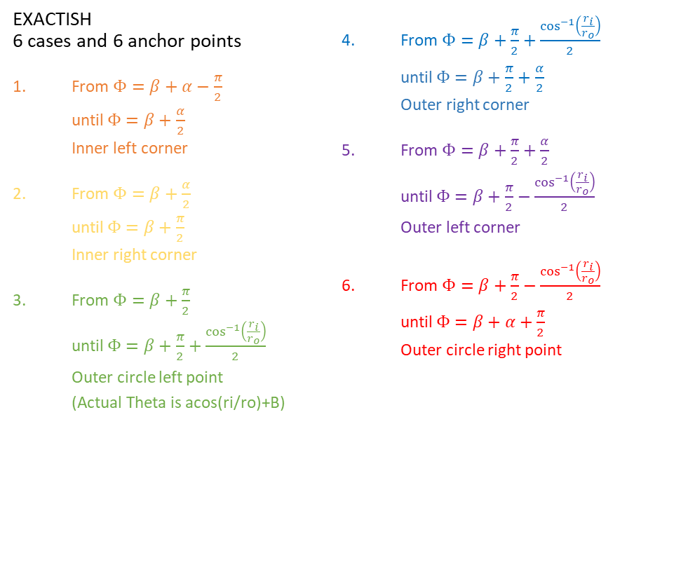



$$\cos^{−1}\left(\frac{r_{i}}{r_{o}}\right)<\frac{α}{2}<\frac{π}{2}$$
EXACTISH 6 cases and 6 anchor points
From $Φ=β+α−\frac{π}{2}$ until $Φ=β+\frac{α}{2}$ Inner left corner
From $Φ=β+\frac{α}{2}$ until $Φ=β+\frac{π}{2}$ Inner right corner
From $Φ=β+\frac{π}{2}$ until $Φ=β+\frac{π}{2}+\frac{\cos^{−1}\left(\frac{r_{i}}{r_{o}}\right)}{2}$ Outer circle left point (Actual Theta is acos(ri/ro)+B)
From $Φ=β+\frac{π}{2}+\frac{\cos^{−1}\left(\frac{r_{i}}{r_{o}}\right)}{2}$ until $Φ=β+\frac{π}{2}+$ $\frac{α}{2}$ Outer right corner
From $Φ=β+\frac{π}{2}+\frac{α}{2}$ until $Φ=β+\frac{π}{2}−\frac{\cos^{−1}\left(\frac{r_{i}}{r_{o}}\right)}{2}$ Outer left corner
From $Φ=β+\frac{π}{2}−\frac{\cos^{−1}\left(\frac{r_{i}}{r_{o}}\right)}{2}$ until $Φ=β+α+\frac{π}{2}$ Outer circle right point
6
3
4
5
α
2
β
$$r_{o}$$
1
$$r_{i}$$

Slide 17
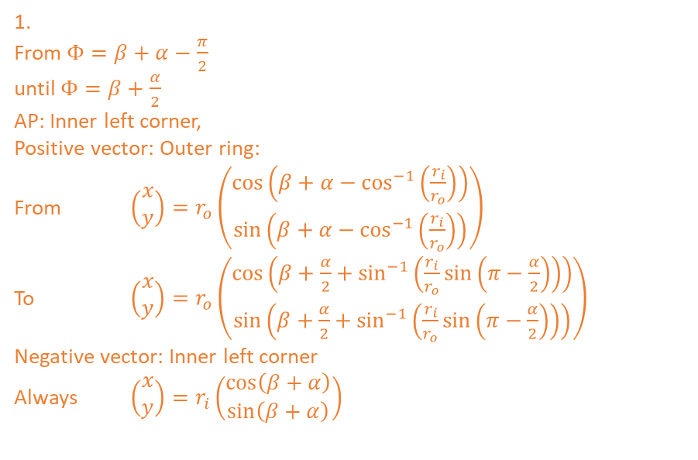
$$\cos^{−1}\left(\frac{r_{i}}{r_{o}}\right)<\frac{α}{2}<\frac{π}{2}$$
Method: linear interpolation between angles
6
3
1.
From $Φ=β+α−\frac{π}{2}$ until $Φ=β+\frac{α}{2}$ AP: Inner left corner, Positive vector: Outer ring: From $\left(\begin{matrix}x \\ y\end{matrix}\right)=r_{o}\left(\begin{matrix}\cos\left(β+α−\cos^{−1}\left(\frac{r_{i}}{r_{o}}\right)\right) \\ \sin\left(β+α−\cos^{−1}\left(\frac{r_{i}}{r_{o}}\right)\right)\end{matrix}\right)$ To $\left(\begin{matrix}x \\ y\end{matrix}\right)=r_{o}\left(\begin{matrix}\cos\left(β+\frac{α}{2}+\sin^{−1}\left(\frac{r_{i}}{r_{o}}\sin\left(π−\frac{α}{2}\right)\right)\right) \\ \sin\left(β+\frac{α}{2}+\sin^{−1}\left(\frac{r_{i}}{r_{o}}\sin\left(π−\frac{α}{2}\right)\right)\right)\end{matrix}\right)$ Negative vector: Inner left corner Always $\left(\begin{matrix}x \\ y\end{matrix}\right)=r_{i}\left(\begin{matrix}\cos\left(β+α\right) \\ \sin\left(β+α\right)\end{matrix}\right)$
4
5
α
2
β
$$r_{o}$$
1
$$r_{i}$$

Slide 18
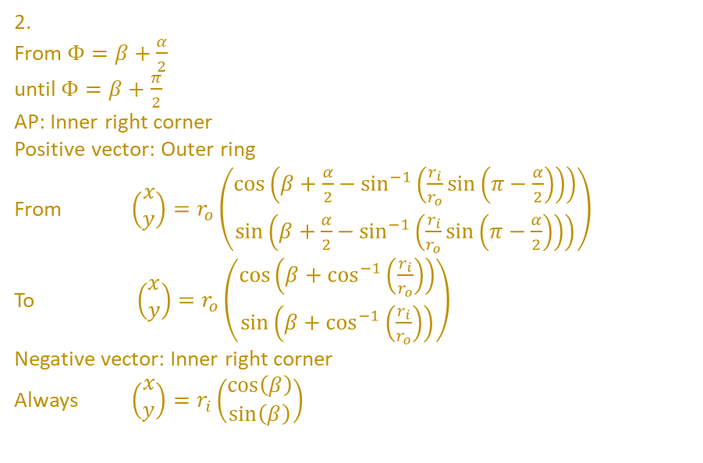
$$\cos^{−1}\left(\frac{r_{i}}{r_{o}}\right)<\frac{α}{2}<\frac{π}{2}$$
Method: linear interpolation between angles
6
3
2.
From $Φ=β+\frac{α}{2}$ until $Φ=β+\frac{π}{2}$ AP: Inner right corner
Positive vector: Outer ring From $\left(\begin{matrix}x \\ y\end{matrix}\right)=r_{o}\left(\begin{matrix}\cos\left(β+\frac{α}{2}−\sin^{−1}\left(\frac{r_{i}}{r_{o}}\sin\left(π−\frac{α}{2}\right)\right)\right) \\ \sin\left(β+\frac{α}{2}−\sin^{−1}\left(\frac{r_{i}}{r_{o}}\sin\left(π−\frac{α}{2}\right)\right)\right)\end{matrix}\right)$ To $\left(\begin{matrix}x \\ y\end{matrix}\right)=r_{o}\left(\begin{matrix}\cos\left(β+\cos^{−1}\left(\frac{r_{i}}{r_{o}}\right)\right) \\ \sin\left(β+\cos^{−1}\left(\frac{r_{i}}{r_{o}}\right)\right)\end{matrix}\right)$ Negative vector: Inner right corner Always $\left(\begin{matrix}x \\ y\end{matrix}\right)=r_{i}\left(\begin{matrix}\cos\left(β\right) \\ \sin\left(β\right)\end{matrix}\right)$
4
5
α
2
β
$$r_{o}$$
1
$$r_{i}$$

Slide 19
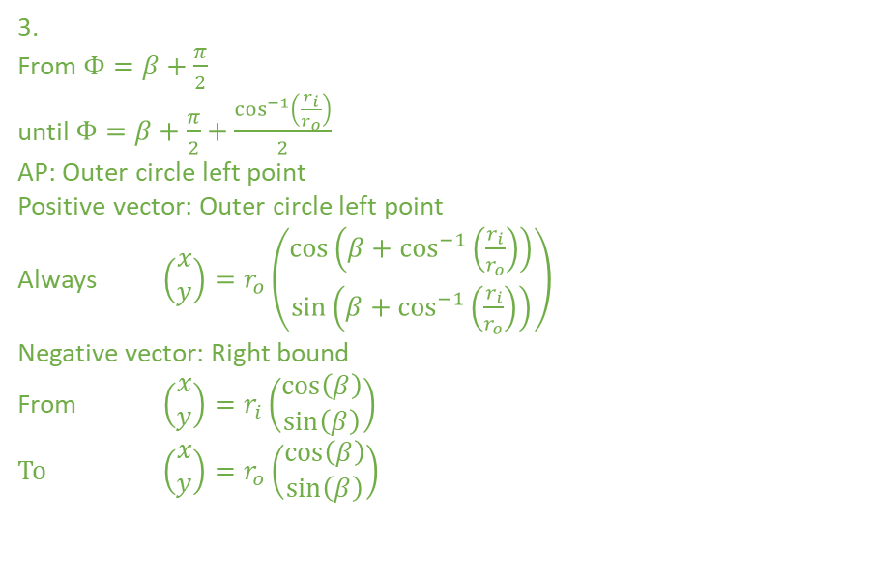
$$\cos^{−1}\left(\frac{r_{i}}{r_{o}}\right)<\frac{α}{2}<\frac{π}{2}$$
Method: linear interpolation between angles
6
3
3.
From $Φ=β+\frac{π}{2}$ until $Φ=β+\frac{π}{2}+\frac{\cos^{−1}\left(\frac{r_{i}}{r_{o}}\right)}{2}$ AP: Outer circle left point Positive vector: Outer circle left point Always $\left(\begin{matrix}x \\ y\end{matrix}\right)=r_{o}\left(\begin{matrix}\cos\left(β+\cos^{−1}\left(\frac{r_{i}}{r_{o}}\right)\right) \\ \sin\left(β+\cos^{−1}\left(\frac{r_{i}}{r_{o}}\right)\right)\end{matrix}\right)$ Negative vector: Right bound From $\left(\begin{matrix}x \\ y\end{matrix}\right)=r_{i}\left(\begin{matrix}\cos\left(β\right) \\ \sin\left(β\right)\end{matrix}\right)$
To $\left(\begin{matrix}x \\ y\end{matrix}\right)=r_{o}\left(\begin{matrix}\cos\left(β\right) \\ \sin\left(β\right)\end{matrix}\right)$
4
5
α
2
β
$$r_{o}$$
1
$$r_{i}$$

Slide 20
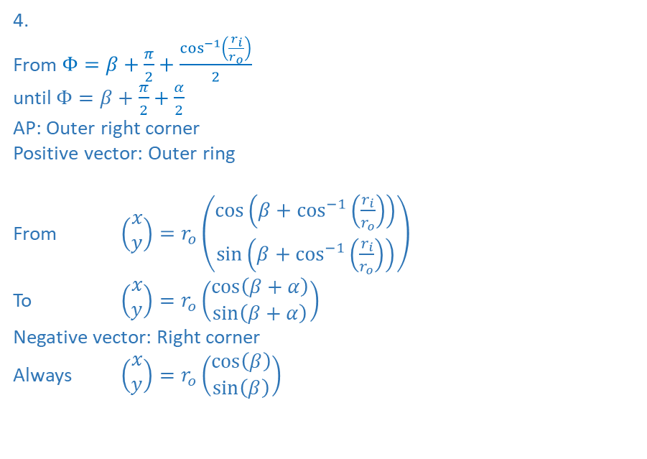
$$\cos^{−1}\left(\frac{r_{i}}{r_{o}}\right)<\frac{α}{2}<\frac{π}{2}$$
Method: linear interpolation between angles
6
3
4.
From $Φ=β+\frac{π}{2}+\frac{\cos^{−1}\left(\frac{r_{i}}{r_{o}}\right)}{2}$ until $Φ=β+\frac{π}{2}+$ $\frac{α}{2}$ AP: Outer right corner
Positive vector: Outer ring
From $\left(\begin{matrix}x \\ y\end{matrix}\right)=r_{o}\left(\begin{matrix}\cos\left(β+\cos^{−1}\left(\frac{r_{i}}{r_{o}}\right)\right) \\ \sin\left(β+\cos^{−1}\left(\frac{r_{i}}{r_{o}}\right)\right)\end{matrix}\right)$
To $\left(\begin{matrix}x \\ y\end{matrix}\right)=r_{o}\left(\begin{matrix}\cos\left(β+α\right) \\ \sin\left(β+α\right)\end{matrix}\right)$ Negative vector: Right corner Always $\left(\begin{matrix}x \\ y\end{matrix}\right)=r_{o}\left(\begin{matrix}\cos\left(β\right) \\ \sin\left(β\right)\end{matrix}\right)$
4
5
α
2
β
$$r_{o}$$
1
$$r_{i}$$

Slide 21
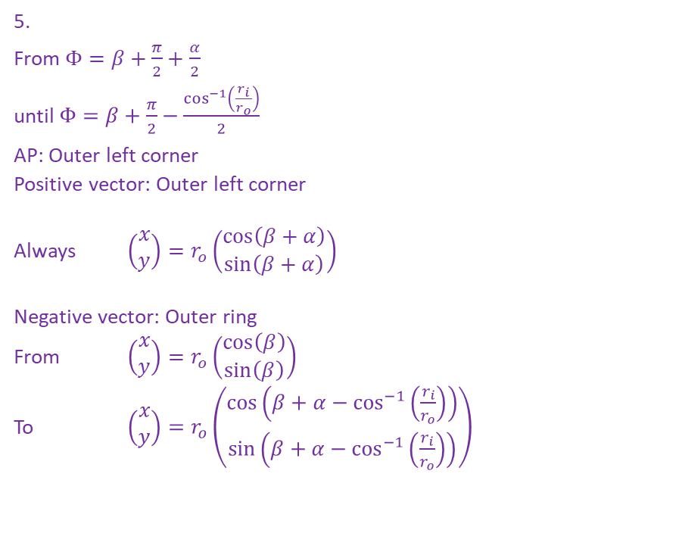
$$\cos^{−1}\left(\frac{r_{i}}{r_{o}}\right)<\frac{α}{2}<\frac{π}{2}$$
Method: linear interpolation between angles
6
3
5.
From $Φ=β+\frac{π}{2}+\frac{α}{2}$ until $Φ=β+\frac{π}{2}−\frac{\cos^{−1}\left(\frac{r_{i}}{r_{o}}\right)}{2}$ AP: Outer left corner
Positive vector: Outer left corner
Always $\left(\begin{matrix}x \\ y\end{matrix}\right)=r_{o}\left(\begin{matrix}\cos\left(β+α\right) \\ \sin\left(β+α\right)\end{matrix}\right)$
Negative vector: Outer ring From $\left(\begin{matrix}x \\ y\end{matrix}\right)=r_{o}\left(\begin{matrix}\cos\left(β\right) \\ \sin\left(β\right)\end{matrix}\right)$
To $\left(\begin{matrix}x \\ y\end{matrix}\right)=r_{o}\left(\begin{matrix}\cos\left(β+α−\cos^{−1}\left(\frac{r_{i}}{r_{o}}\right)\right) \\ \sin\left(β+α−\cos^{−1}\left(\frac{r_{i}}{r_{o}}\right)\right)\end{matrix}\right)$
4
5
α
2
β
$$r_{o}$$
1
$$r_{i}$$

Slide 22
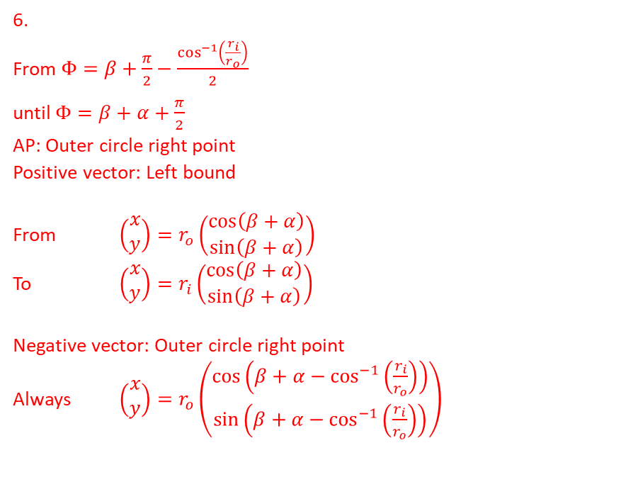
$$\cos^{−1}\left(\frac{r_{i}}{r_{o}}\right)<\frac{α}{2}<\frac{π}{2}$$
Method: linear interpolation between angles
6
3
6.
From $Φ=β+\frac{π}{2}−\frac{\cos^{−1}\left(\frac{r_{i}}{r_{o}}\right)}{2}$ until $Φ=β+α+\frac{π}{2}$ AP: Outer circle right point
Positive vector: Left bound
From $\left(\begin{matrix}x \\ y\end{matrix}\right)=r_{o}\left(\begin{matrix}\cos\left(β+α\right) \\ \sin\left(β+α\right)\end{matrix}\right)$
To $\left(\begin{matrix}x \\ y\end{matrix}\right)=r_{i}\left(\begin{matrix}\cos\left(β+α\right) \\ \sin\left(β+α\right)\end{matrix}\right)$
Negative vector: Outer circle right point Always $\left(\begin{matrix}x \\ y\end{matrix}\right)=r_{o}\left(\begin{matrix}\cos\left(β+α−\cos^{−1}\left(\frac{r_{i}}{r_{o}}\right)\right) \\ \sin\left(β+α−\cos^{−1}\left(\frac{r_{i}}{r_{o}}\right)\right)\end{matrix}\right)$
4
5
α
2
β
$$r_{o}$$
1
$$r_{i}$$

Slide 23
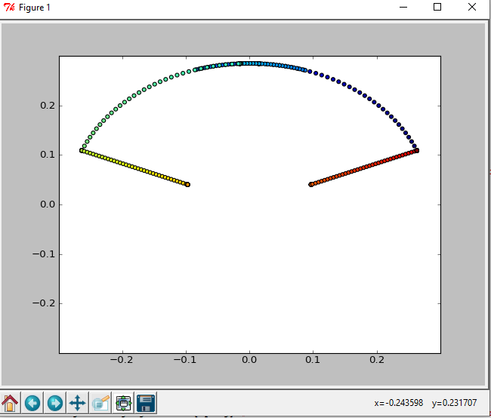
Foot selection shown in python for leg 0

Slide 24


$$\frac{α}{2}<\cos^{−1}\left(\frac{r_{i}}{r_{o}}\right), \frac{α}{2}<\frac{π}{2}$$
3 cases and 3 anchor points
From $Φ=β+α−\frac{π}{2}$ until $Φ=β+\frac{α}{2}$ Inner left corner
From $Φ=β+\frac{α}{2}$ until $Φ=β+\frac{π}{2}$ Inner right corner
From $Φ=β+\frac{π}{2}$ until $Φ=β+α+\frac{π}{2}$ Tangent of inner circle
3
2
α
β
1
$$r_{o}$$
$$r_{i}$$

Slide 25

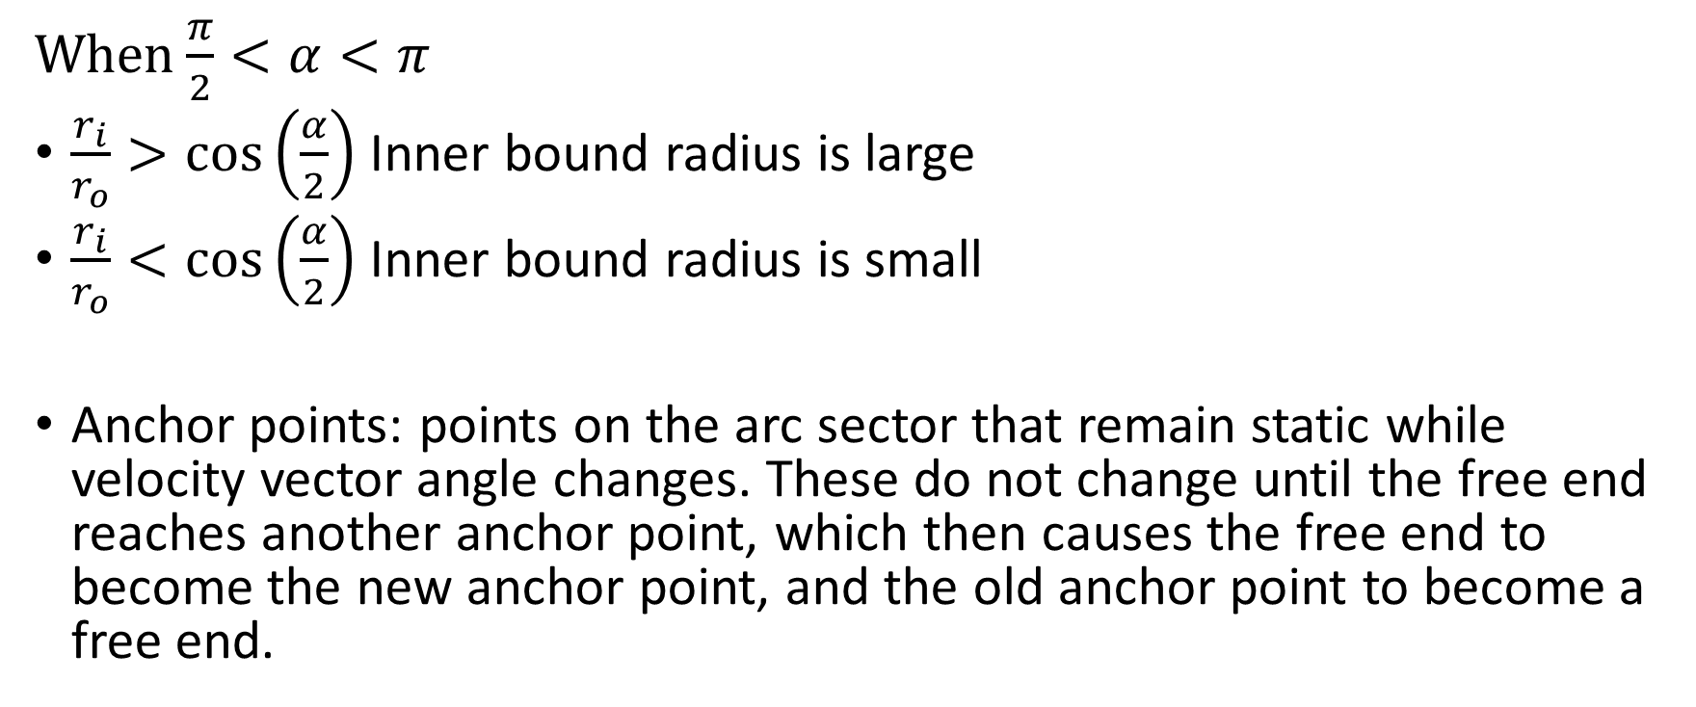

OLD!!! Two relevant cases for the robot
When$\frac{π}{2}<α<π$
$\frac{r_{i}}{r_{o}}>\cos\left(\frac{α}{2}\right)$ Inner bound radius is large
$\frac{r_{i}}{r_{o}}<\cos\left(\frac{α}{2}\right)$ Inner bound radius is small
Anchor points: points on the arc sector that remain static while velocity vector angle changes. These do not change until the free end reaches another anchor point, which then causes the free end to become the new anchor point, and the old anchor point to become a free end.
α
β
$$r_{o}$$
$$r_{i}$$

Slide 26
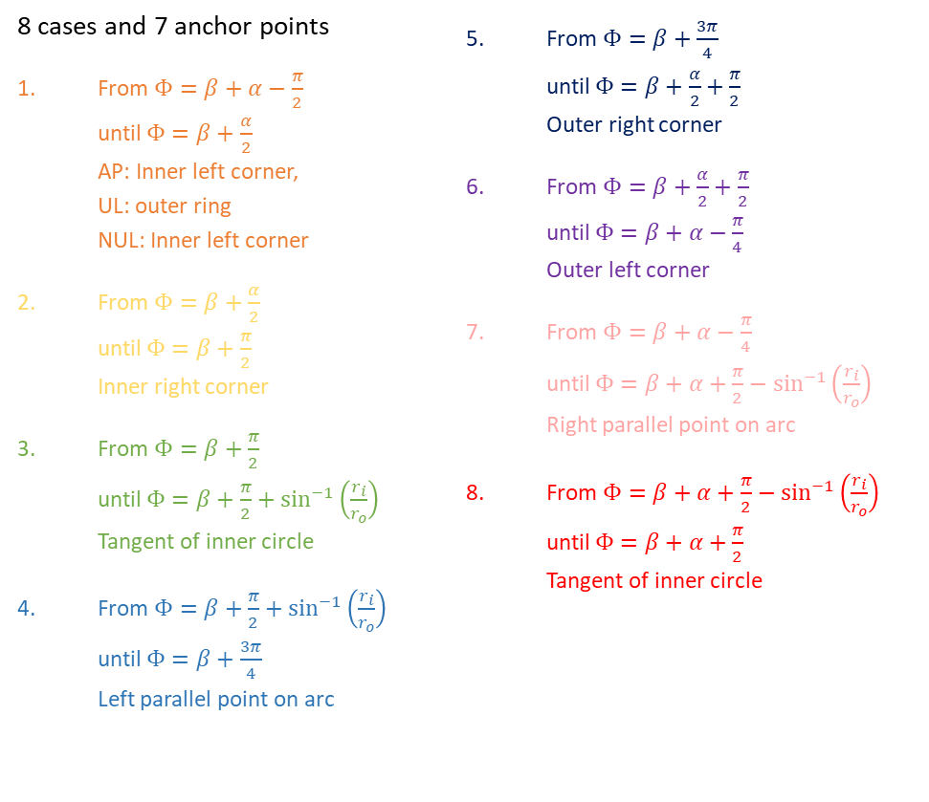
$$\cos^{−1}\left(\frac{r_{i}}{r_{o}}\right)<\frac{α}{2}<\frac{π}{2}$$
8 cases and 7 anchor points
From $Φ=β+α−\frac{π}{2}$ until $Φ=β+\frac{α}{2}$ AP: Inner left corner, UL: outer ring NUL: Inner left corner
From $Φ=β+\frac{α}{2}$ until $Φ=β+\frac{π}{2}$ Inner right corner
From $Φ=β+\frac{π}{2}$ until $Φ=β+\frac{π}{2}+\sin^{−1}\left(\frac{r_{i}}{r_{o}}\right)$ Tangent of inner circle
From $Φ=β+\frac{π}{2}+\sin^{−1}\left(\frac{r_{i}}{r_{o}}\right)$ until $Φ=β+\frac{3π}{4}$ Left parallel point on arc
From $Φ=β+\frac{3π}{4}$ until $Φ=β+\frac{α}{2}+\frac{π}{2}$ Outer right corner
From $Φ=β+\frac{α}{2}+\frac{π}{2}$ until $Φ=β+α−\frac{π}{4}$ Outer left corner
From $Φ=β+α−\frac{π}{4}$ until $Φ=β+α+\frac{π}{2}−\sin^{−1}\left(\frac{r_{i}}{r_{o}}\right)$ Right parallel point on arc
From $Φ=β+α+\frac{π}{2}−\sin^{−1}\left(\frac{r_{i}}{r_{o}}\right)$ until $Φ=β+α+\frac{π}{2}$ Tangent of inner circle
7
4
5
6
3,8
β
$$r_{o}$$
α
2
1
$$r_{i}$$

